Slide 1



Slide 2



01CE0701 – Mobile Computing
Unit - 4
Mobile IP

Slide 3


Outline
Introduction of Mobile IP
Need of Mobile IP
Components of Mobile IP
Working of Mobile IP
IP packet delivery
Agent Discovery
Registration
Tunnelling and encapsulation
Route optimization
IP Handoff

Slide 4

Introduction of Mobile IP

Slide 5
Introduction of Mobile IP
The concept and role of Mobile IP are very important in the field of mobile computing technology.
Mobile IP is based on IP, so it is scalable for the Internet. Any media that supports IP can also support Mobile IP.
In IP networks, when a device is within its home network, the routing is based on the static IP addresses.
The device within a network is connected through normal IP routing by the IP address assigned on the network.
It is the same as how a postal letter is delivered to the fixed address on the envelope.
The problem occurs when a device goes away from its home network and is no longer reachable using normal IP routing.
In this condition, the active sessions of the device are terminated.
In this situation, you must reconfigure the mobile node with a different IP address representative of its new location.

Slide 6
Introduction of Mobile IP
Thus, under the current Internet Protocol, if the mobile node moves without changing its address, it loses routing; but if it does change its address, it loses connections.
Mobile IP solves this problem by allowing the mobile node to use two IP addresses: a fixed home address and a care-of address that changes at each new point of attachment.
Mobile IP: It is a communication protocol (created by extending Internet Protocol, IP) that allows the users to move from one network to another with the same IP address.
Home Address: The “normal”, permanent IP address assigned to the mobile node. This is the address used by the device on its home network, and the one to which datagrams intended for the mobile node are always sent.
Care-Of Address: A secondary, temporary address used by a mobile node while it is 'traveling” away from its home network. It is a normal 32-bit IP address in most respects, but is used only by Mobile IP for forwarding IP datagrams and for administrative functions. Higher layers never use it, nor do regular IP devices when creating datagrams.

Slide 7
Need of Mobile IP

Slide 8
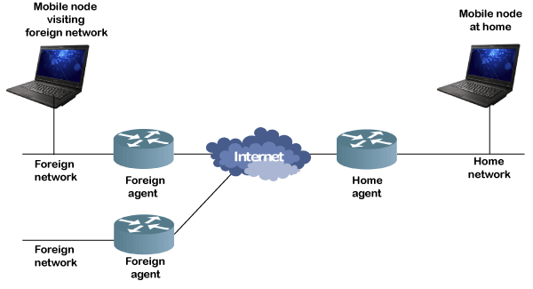
Need of Mobile IP
Mobile IP is a communication protocol (created by extending Internet Protocol, IP) that allows the users to move from one network to another with the same IP address.
It ensures that the communication will continue without user’s sessions or connections being dropped.
Mobile IP enables a computer to roam freely on the Internet or an organization's network while still maintaining the same home address.

Slide 9
Components of Mobile IP

Slide 10
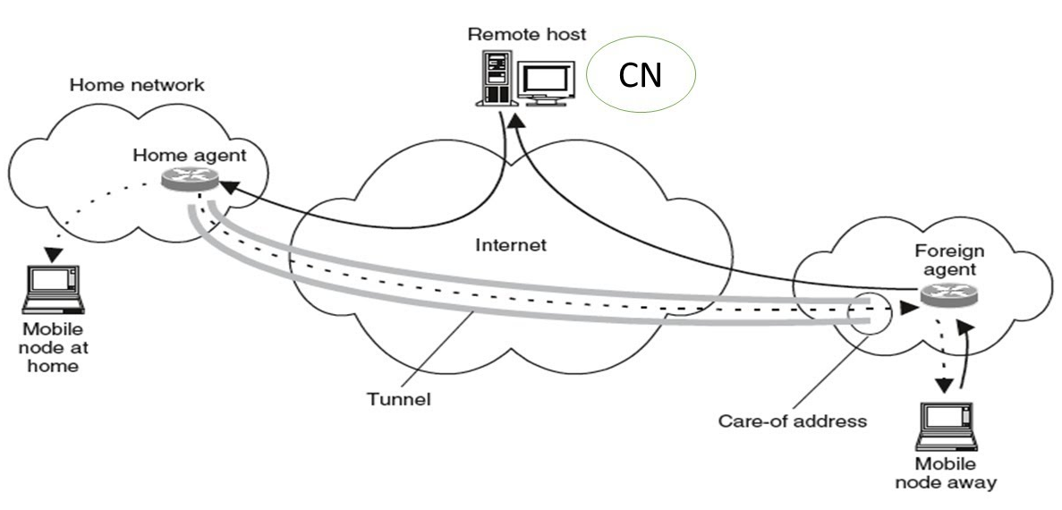
Components of Mobile IP
Mobile Node (MN) is the hand-held communication device that the user carries e.g. Cell phone.
Home Network is a network to which the mobile node originally belongs as per its assigned IP address (home address).
Home Agent (HA) is a router in-home network to which the mobile node was originally connected
Home Address is the permanent IP address assigned to the mobile node (within its home network).
Foreign Network is the current network to which the mobile node is visiting (away from its home network).
Foreign Agent (FA) is a router in a foreign network to which the mobile node is currently connected. The packets from the home agent are sent to the foreign agent which delivers them to the mobile node.

Slide 11
Components Mobile IP
Correspondent Node (CN) is a device on the internet communicating to the mobile node.
Care-of Address (COA) is the temporary address used by a mobile node while it is moving away from its home network.
Foreign agent COA, the COA could be located at the FA, i.e., the COA is an IP address of the FA. The FA is the tunnel end-point and forwards packets to the MN. Many MN using the FA can share this COA as a common COA.

Slide 12
Working of Mobile IP

Slide 13
Working of Mobile IP - IP Packet Delivery
Home Network for A
Foreign Network
Mobile Node A
4
3
Home Agent
Internet or other topology or routers and links
Foreign Agent
2
1
5
Server X
At foreign network, the incoming IP datagram is intercepted by the foreign agent.
The foreign agent is the counterpart of the home agent in the foreign network.
A uses X’s IP static address as the destination address in the IP header.
The IP datagram from A to X travels directly across the network, using X’s IP address as the destination address.
The IP datagram is routed to A’s home network. At the A’s home network, the incoming IP datagram is intercepted by the home agent.
For routing A’s IP datagram to X, each datagram is sent to some router in the foreign network. Typically, this router is the foreign agent.
Server X wants to transmit an IP datagram to node A.
The home address of A is advertised and known to X.
X does not know whether A is in the home network or somewhere else.
Therefore, X sends the packet to A with A’s home address as the destination IP address in the IP header.
A care of address has been allocated to A by this foreign network and available with the home agent.
The home agent encapsulates the entire datagram inside a new IP datagram, with A’s care of address in the IP header.
This new datagram with the care of address as the destination address is retransmitted by the home agent.
A intends to respond to this message and sends traffic to X.
In this example, X is not mobile; therefore X has a fixed IP address.
The foreign agent strips off the outer IP header, and delivers the original datagram to A.
The home agent discovers that A is in a foreign network.

Slide 14
Working of Mobile IP
There are 3 phases:
Discovery - A mobile node uses a discovery procedure to identify prospective home agents and foreign agents.
Registration - A mobile node uses a registration procedure to inform its home agent of its care-of address.
Tunneling - Tunneling procedure is used to forward IP datagrams from a home address to a care of address.

Slide 15
Working of Mobile IP
Discovery - A mobile node uses a discovery procedure to identify prospective home agents and foreign agents.
During the agent discovery phase the HA and FA advertise their services on the network by using the ICMP (Internet Control Message Protocol) and router discovery protocol (RDP).
Mobile IP defines two methods: agent advertisement and agent solicitation which are in fact router discovery methods.

Slide 16
Working of Mobile IP
Agent Advertisement
HA’s and FA’s broadcast their presence on each network to which they are attached
Beacon messages via ICMP (Internet Control Message Protocol) and RDP (Router Discovery Protocol)
MN’s listen for advertisement and then initiate registration
Agent solicitation:
If no agent advertisements are present or the inter arrival time is too high
MN has not received a COA
MN must send agent solicitations.

Slide 17
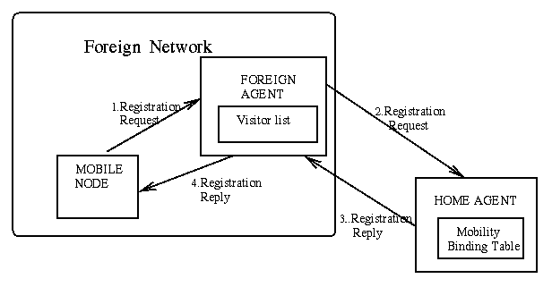
Working of Mobile IP
Registration - The main purpose of the registration is to inform the home agent of the current location for correct forwarding of packets.
Registration can be done in two ways depending on the location of the COA.
If the COA is at the FA, the MN sends its registration request containing the COA to the FA which is forwarding the request to the HA. The HA now set up a mobility binding containing the mobile node's home IP address and the current COA.
If the COA is co-located, registration can be very simpler. The mobile node may send the request directly to the HA and vice versa. This is also the registration procedure for MNs returning to their home network.

Slide 18
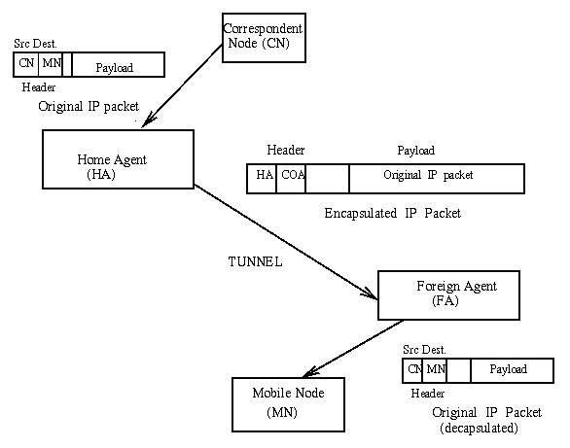
Working of Mobile IP
Tunneling - Tunneling procedure is used to forward IP datagrams from a home address to a care of address.
A tunnel is used to establish a virtual path for data packets between a tunnel entry and a tunnel endpoint. Packets which are entering in a tunnel are forwarded inside the tunnel and leave the tunnel unchanged. Tunneling, i.e., sending a packet through a tunnel is achieved with the help of encapsulation.
Tunneling is also known as "port forwarding" is the transmission and data intended for use only within a private, usually corporate network through a public network.

Slide 19
Route Optimization

Slide 20
Route Optimization
Binding Update
How does a “correspondent host” will learn the current binding for the mobile node?
Let the mobile node inform the correspondent host!
For example when it receives a packet from a correspondent host
Let the home agent inform the correspondent host.
This is the method chosen, since it is easier to establish security association between a home agent and a correspondent host (Binding update should be secure so the malicious users can not send binding updates to the corresspondent hosts without authenticating themselves).

Slide 21
Route Optimization
Binding Request/Warning
A correspondent host may request a binding Update message from Home agent.
Correspondent host sends a Binding Request message and waits for a Binding Update Message.
A mobile node may warn a Home agent to send a Binding Update message to a correspondent host (for authentication purpose)
Mobile node sends a Binding Warning message to home agent.
Binding warning message include the host IP address to where an Update will be sent.

Slide 22
IP Handoff

Slide 23
IP Handoff
Smooth Handoff issue
For highly mobile users, handoffs will be too frequent. Implications of this:
Handoffs should be very fast in order to minimize packet delays and packet losses.
Registration will be too frequent:
Registration causes delay
Registration causes extra signaling (control) traffic in the wireless link and infrastructure.
Two solution approaches to support fast handoffs:
Use of IP multicasting
Use of hierarchical foreign agents

